Slide 1
SAFETY
IN SPORTS

Slide 2
Warm-up
BEGINNING
IT PREPARES YOUR BODY TO SAFELY MOVE & ALLOWS YOUR BODY TO RETURN TO A RESTING STATE
Cool Down
END

Slide 3
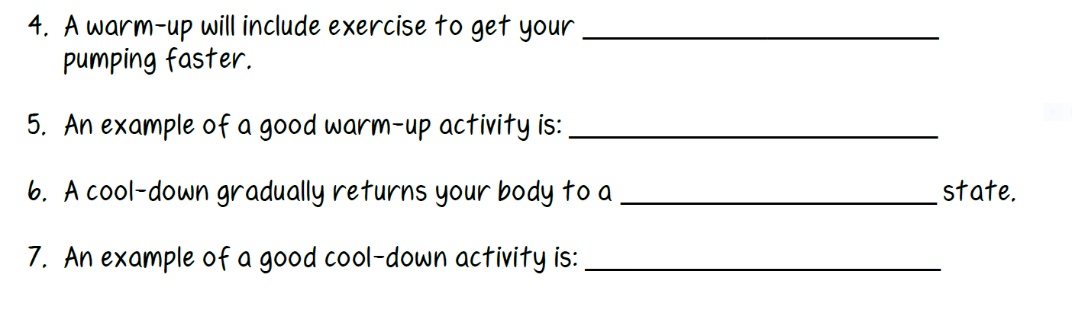
HEART
JUMPING JACKS
RESTING
WALKING

Slide 4
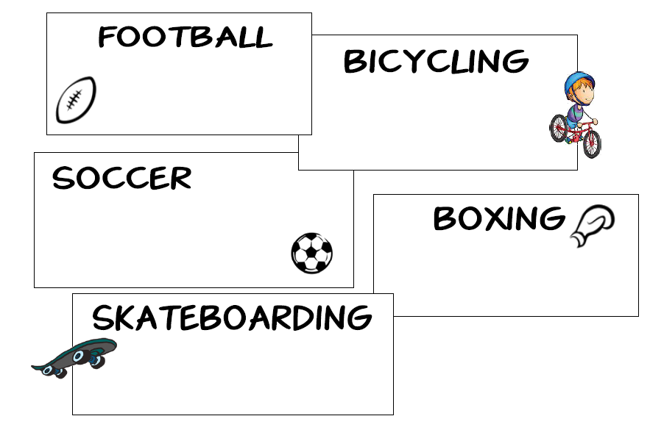
SAFETY GEAR

Slide 5
COMMON SPORTS INJURIES
Sprain
1. ______________ (torn ligament – attaches bone to bone)
______________ (torn muscle or tendon – attaches muscle to bone, stretched too far)
Strain

Slide 6
COMMON SPORTS INJURIES
bones
2. Broken __________ or fractures
3. _______________(swelling of tissue) from repeating a motion
______________ related (dehydration, heat exhaustion)
______________ - brain injury that alters the way your brain functions
Inflammation
Weather
Concussion

Slide 7
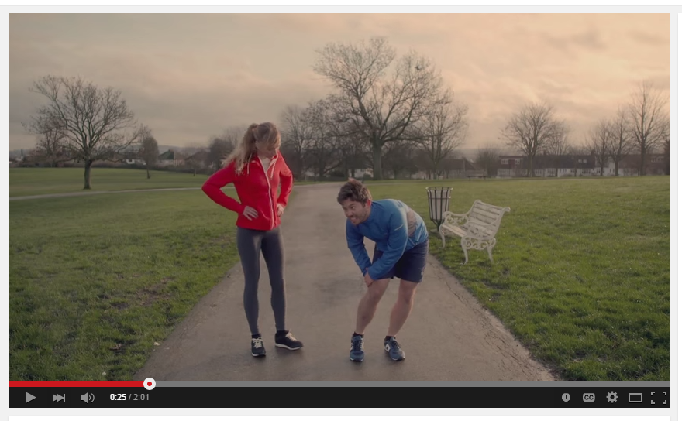
P.R.I.C.E.

Slide 8
P.R.I.C.E.
PROTECT
REST
ICE
COMPRESS
ELEVATE

Slide 9
WEATHER RELATED INJURIES
 | DEHYDRATION
WHAT IS IT? | Not enough water
HOW DO I PREVENT IT? | Drink water
WHAT ARE SOME SIGNS OF THIS? | Thirsty, headache, tired, dizziness

Slide 10
WEATHER RELATED INJURIES
 | HEAT EXHAUSTION
WHAT IS IT? | Overheating of body
HOW DO I PREVENT IT? | Drink fluids, shade
WHAT ARE SOME SIGNS OF THIS? | Dizzy, headache, clammy skin

Slide 11
WEATHER RELATED INJURIES
 | FROST BITE
WHAT IS IT? | Freezing of skin
HOW DO I PREVENT IT? | Stay indoors, layers
WHAT ARE SOME SIGNS OF THIS? | Numb, pale, stiff

